Slide 1
Transformer
Group 4
Jiacong Wu, Haohui Wu, Xin Tian, Hanyi Yu

Slide 2
Transformer In General
Artificial Intelligence, Machine Learning, Deep Learning and Neural networks
Things we need and we will produce:
→ Input data / training data;
→ Model, Error / loss function (for model update), Optimization Algorithm;
→ data, texts, images etc.
From attention mechanism to Transformer (2015-2017)
Published in paper Attention is all you need (2017)

Slide 3
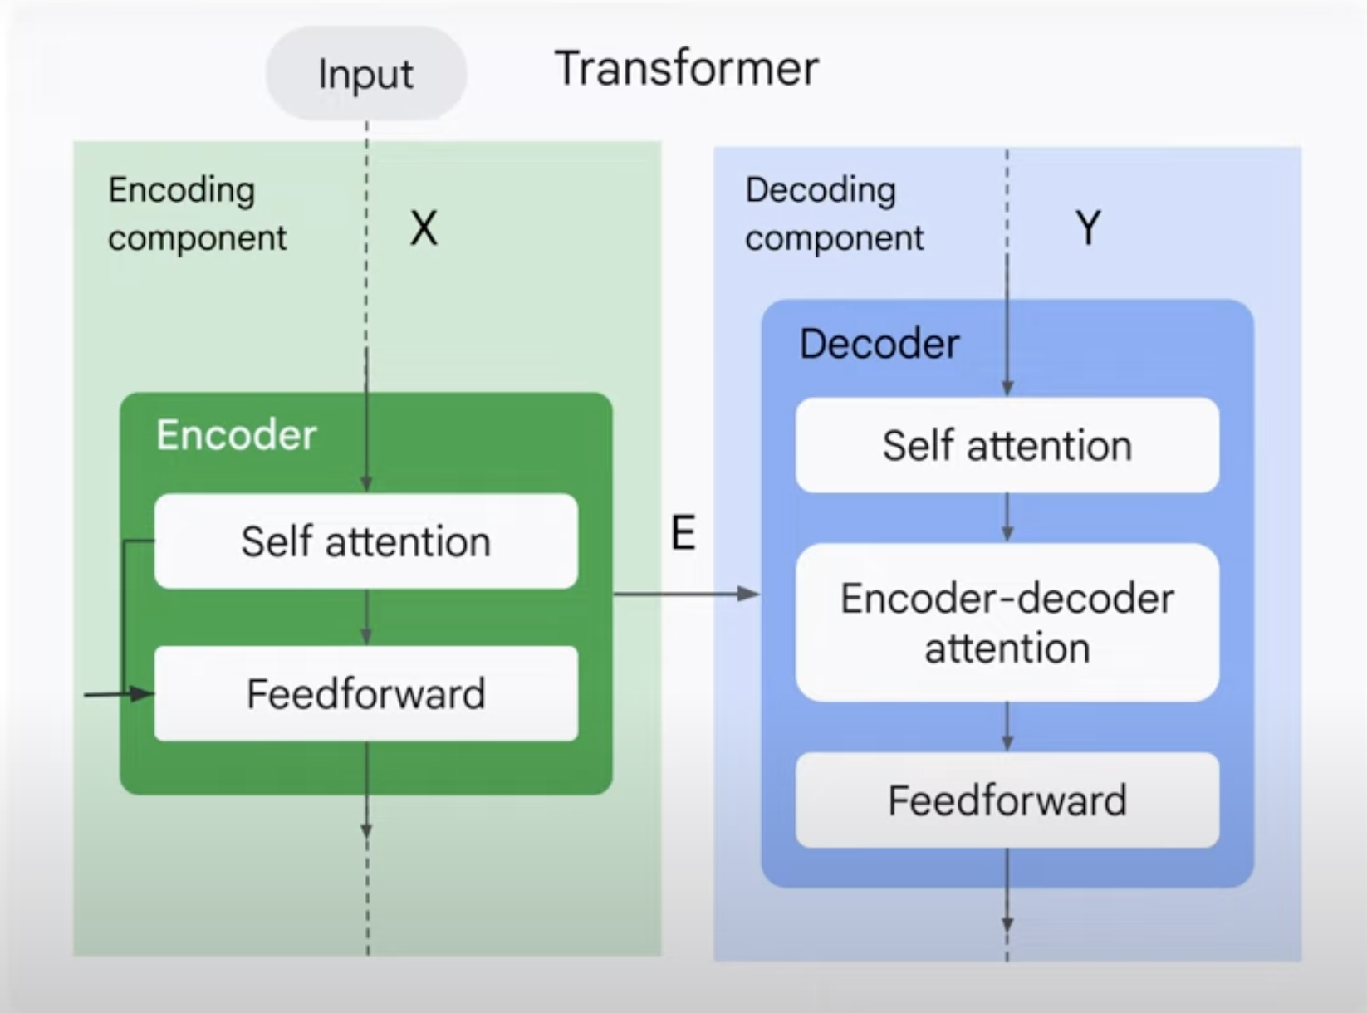
Transformer in General
4. Encoder & Decoder Architecture

Slide 4
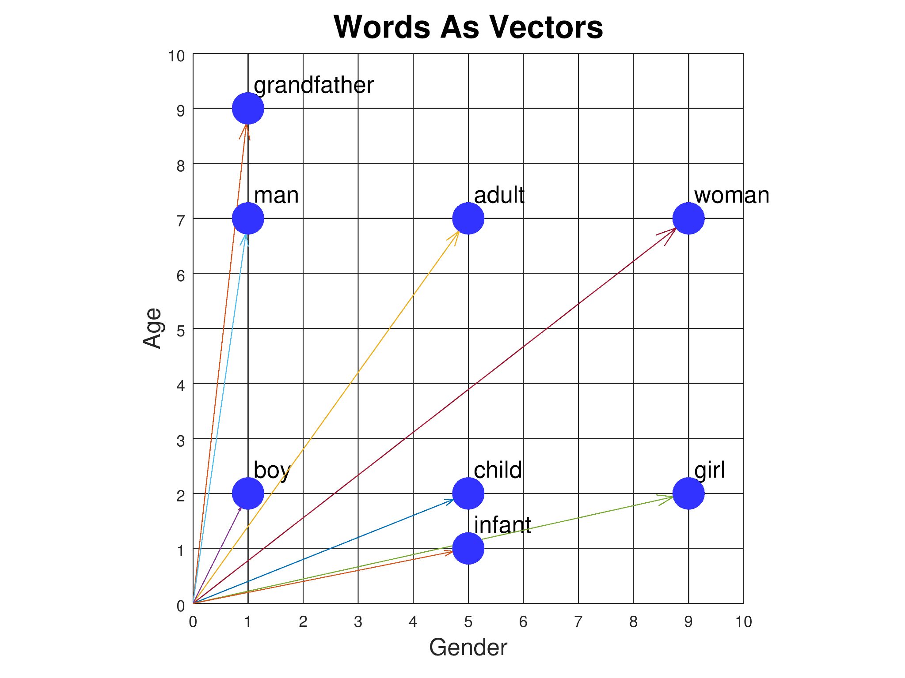
Encoder: Input Embedding Layer
Embeddings:
Individual words → real valued vectors in lower dimensional space
Difference in embedding between traditional methods and GPT, BERT
Layer: Capture semantic meanings of tokens, initial input of following layers

Slide 5
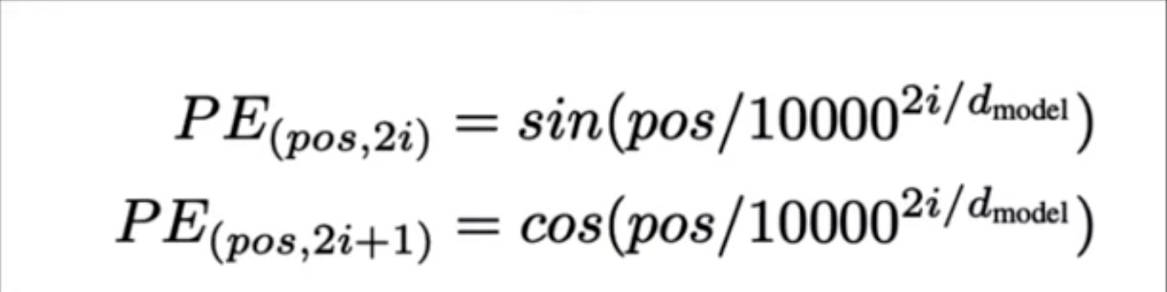
Positional Encoding
Convey the position of each token within the sequence
Summing together the word embeddings and positional encoding, we form the final input representation for the Transformer model

Slide 6
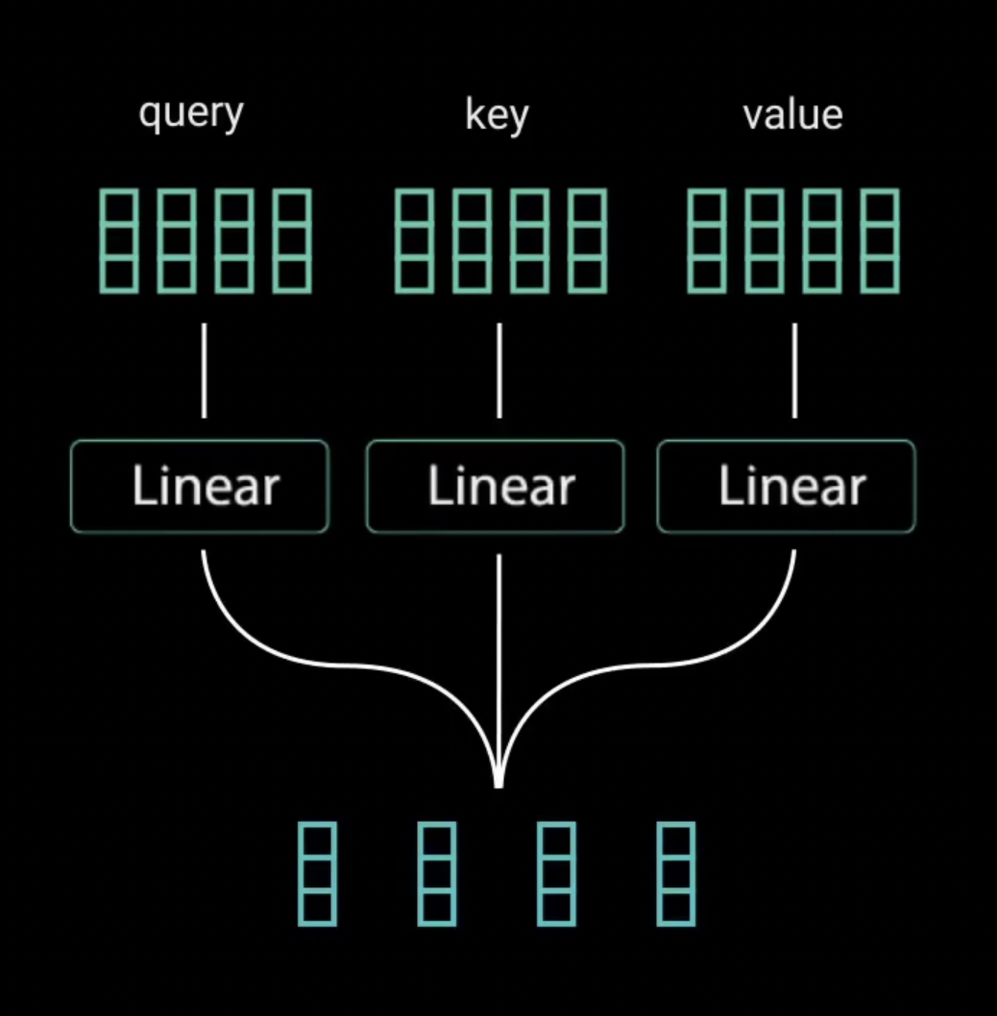
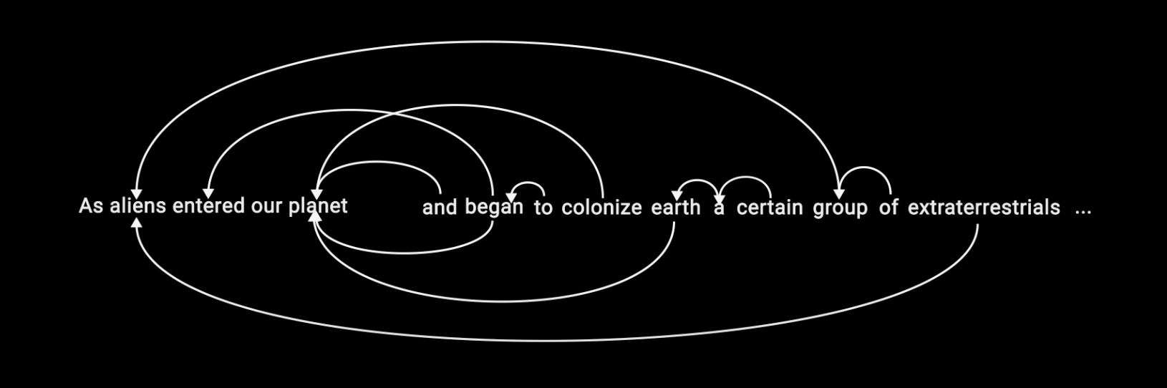
Multi-Head Attention
Self Attention
Self attention allows every word in the the sentence to connect with other words in the same sentence.
Images from https://www.youtube.com/watch?v=4Bdc55j80l8

Slide 7
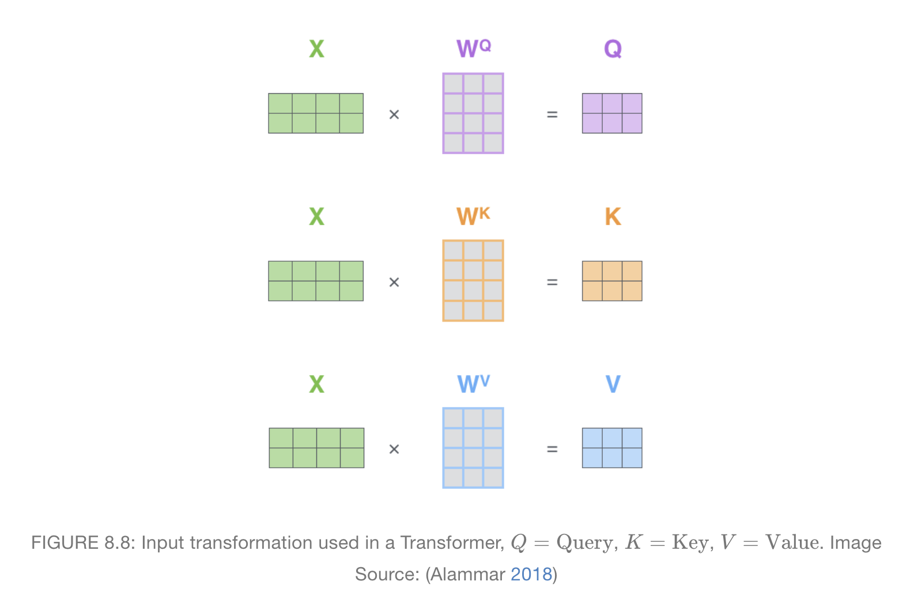
Query, Key, Value Matrices
𝑄,𝐾,𝑉 are usually from the same source, so such operation is called self-attention.
The key/value/query concept is analogous to retrieval systems. For example, when you search for videos on Youtube, the search engine will map your query (text in the search bar) against a set of keys (video title, description, etc.) associated with candidate videos in their database, then present you the best matched videos (values).
Image source : https://slds-lmu.github.io/seminar_nlp_ss20/attention-and-self-attention-for-nlp.html

Slide 8
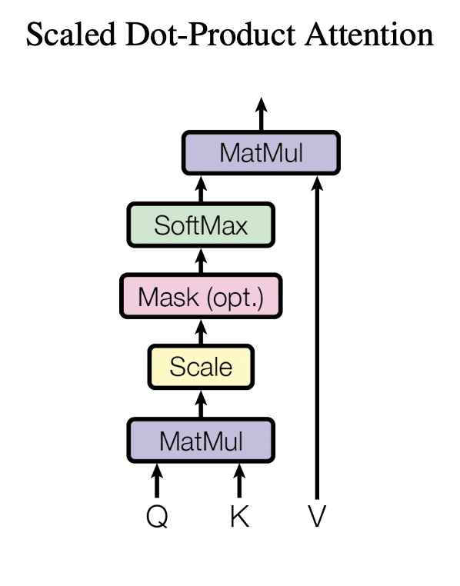
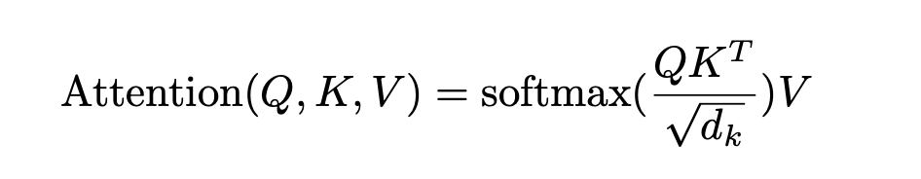
Scaled Dot-Product Attention
Take the dot-product multiplication of Q and K-transpose to get a score matrix
Score matrix determines how much focus should a word be put on another
Scale down the score matrix by dividing by square root of the dimension of K
To lower the variance from d_k to 1
Apply the softmax() function
To make the scaled scores between 0 to 1 as probabilities
Finally take the dot-product multiplication of the result of softmax() function with the Value matrix
To get the attention weights
Visualization of the formula from: Attention is all you need

Slide 9
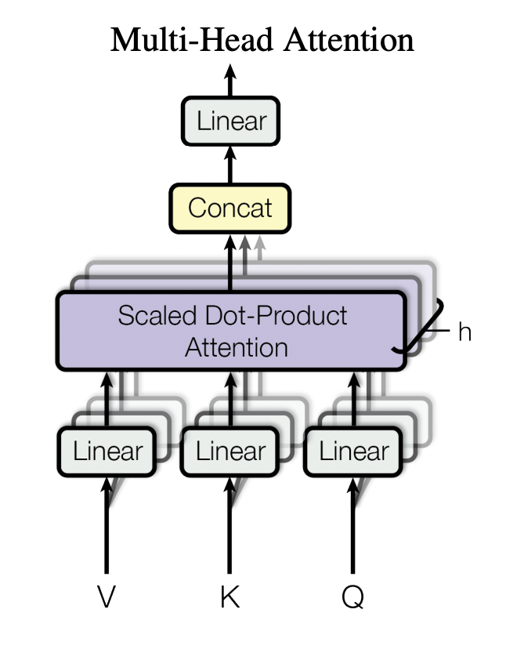
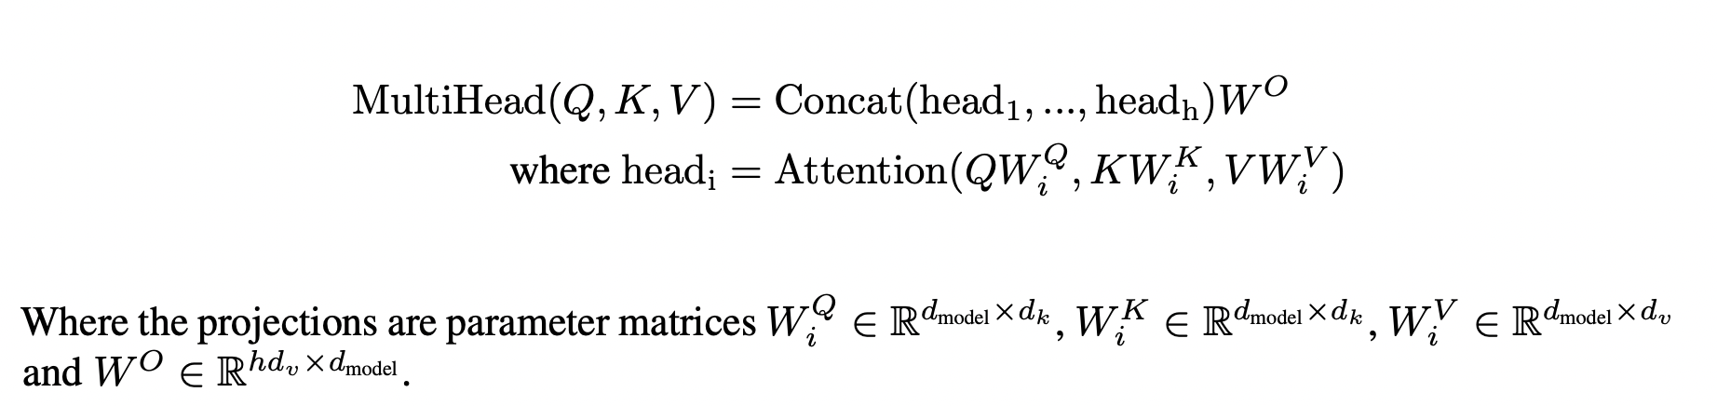
Multi-Head attention
Generate h sets of V, K, and Q matrices
Repeat the self attention process individually for h times
Each self attention process is called a head
Every head generates an output matrix
Concatenate all of the output matrices
Go through a linear layer and generates a sequence

Slide 10
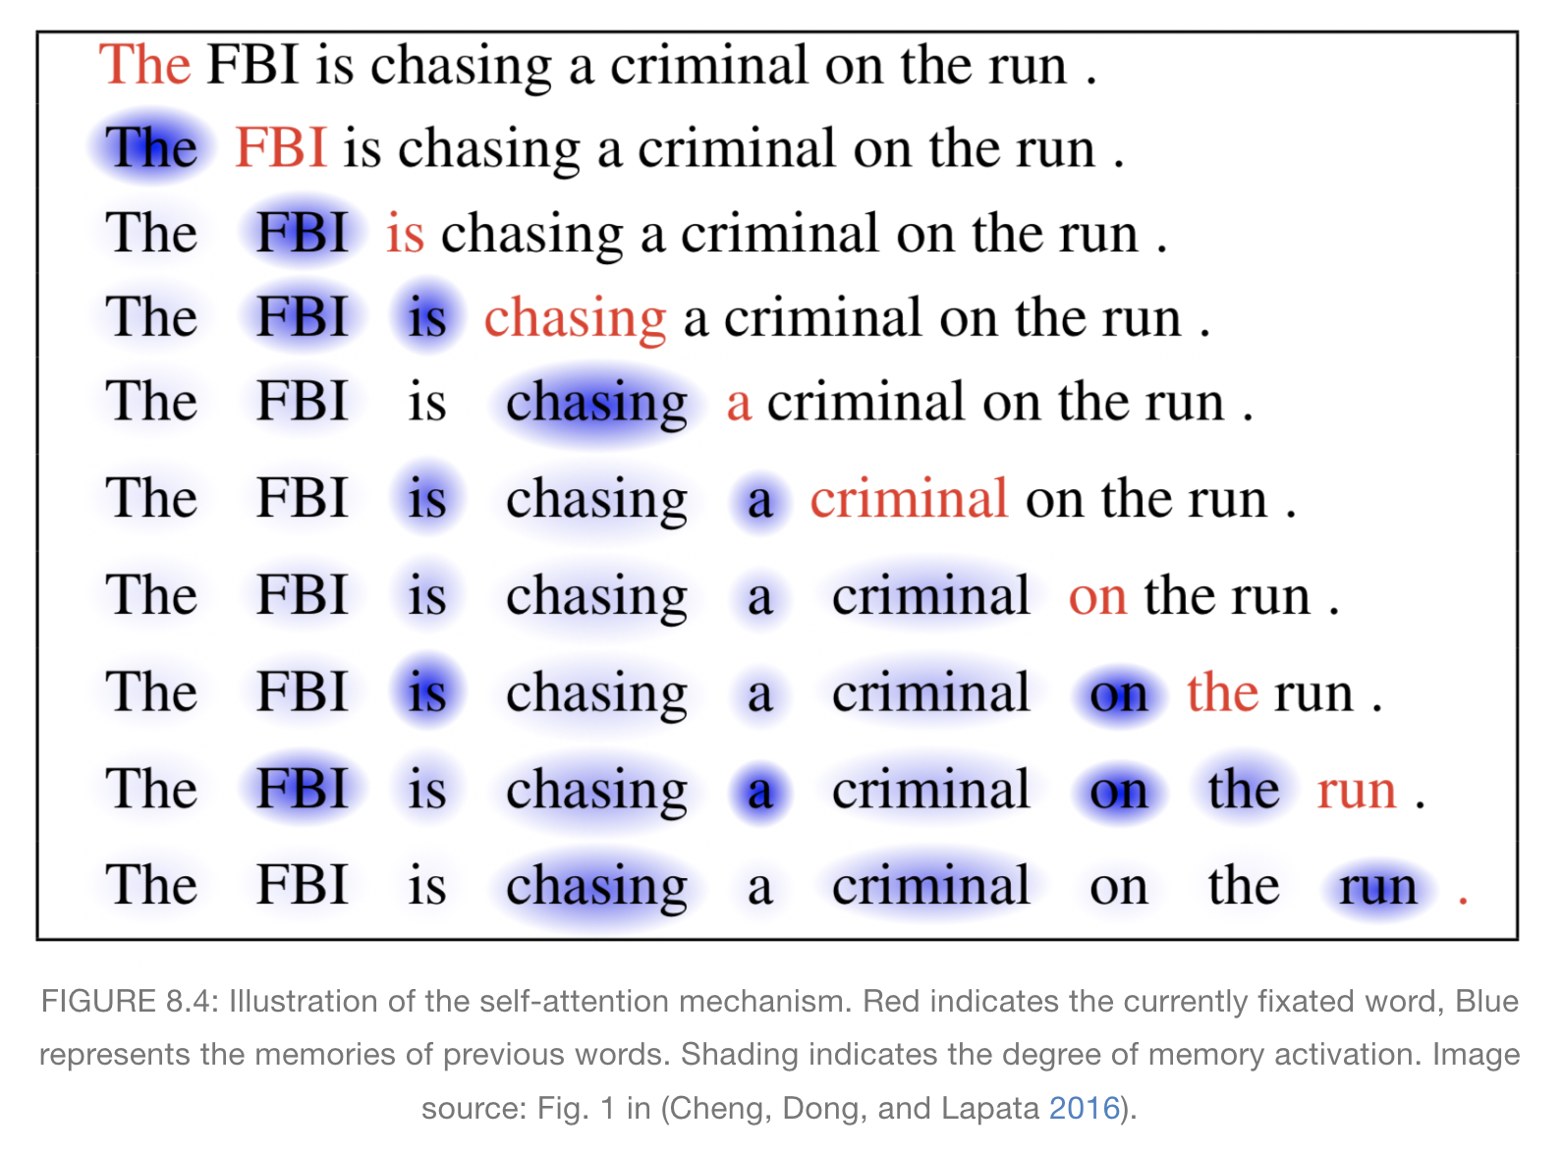
Image source : https://slds-lmu.github.io/seminar_nlp_ss20/attention-and-self-attention-for-nlp.html

Slide 11
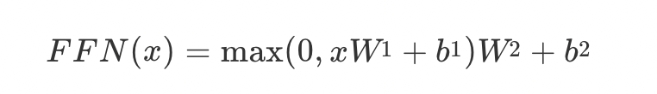
Position-wise Feed-Forward Networks

Slide 12
Normalization
Layer Normalization
Batch Normalization

Slide 13
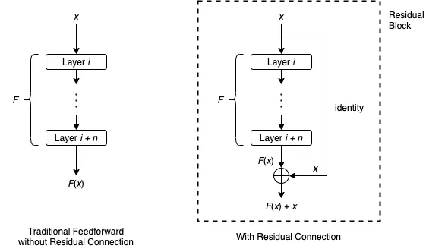
Residual connection

Slide 14
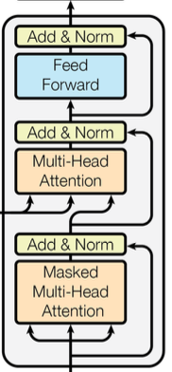
Decoder
Similar to encoder
Decoding the encoded input into the target sequence
Masked multihead-attention
Prevent attending to subsequent position
Ensure prediction only depends on current knowledge

Slide 15
Why self-attention?
Computational complexity
Parallelizable computation
Path length between long-range dependencies

Slide 16
Application of transformer
NLP: Translation, Summarization, Sentiment Analysis
Models
BERT: Bidirectional Encoder Representation from Transformer
GPT
T5: Text-to-text Transfer Transformer
Search engine, Voice assistants, Content generation

